Slide 1
OO Design Patterns
Coding Cleverly
Notes:
<number>

Slide 2
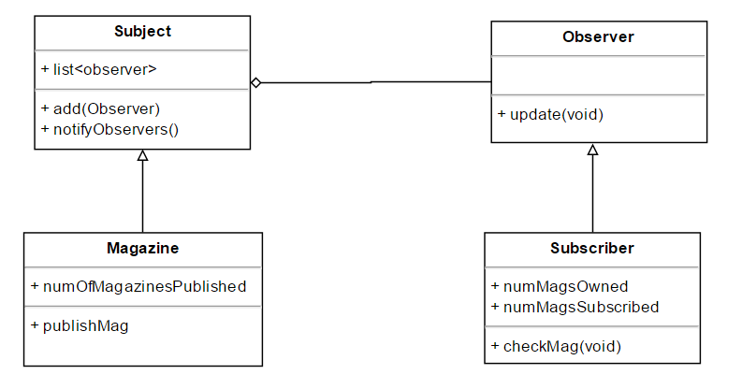
Observer
Notes:
<number>

Slide 3
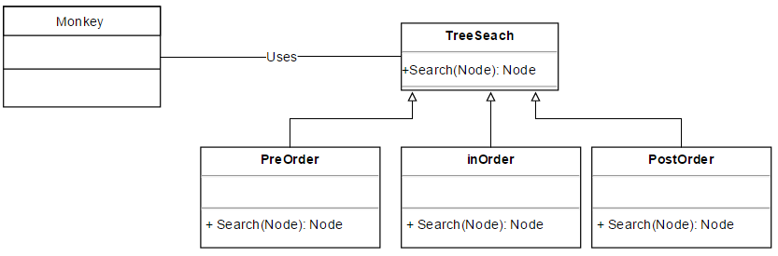
Strategy
Notes:
<number>

Slide 4
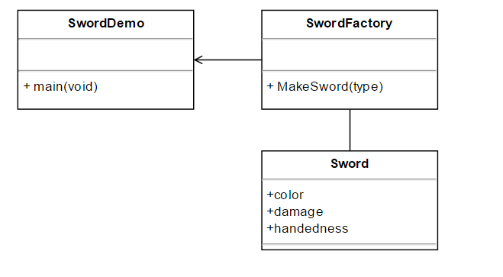
Factory
Notes:
<number>

Slide 5
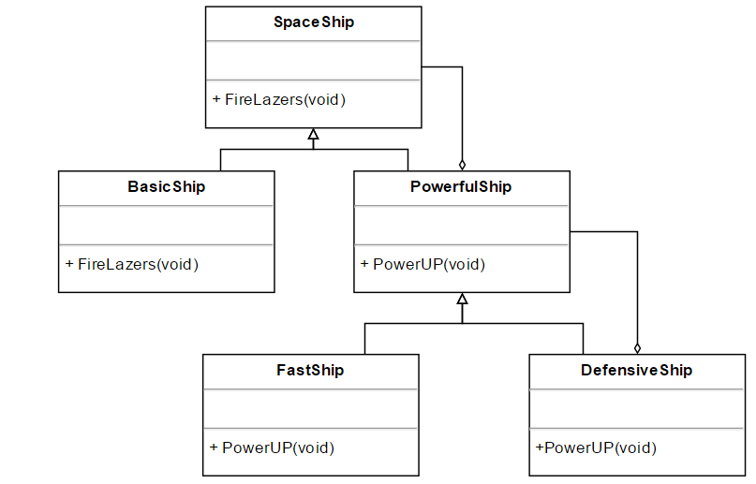
Decorator Pattern
Notes:
<number>

Slide 6
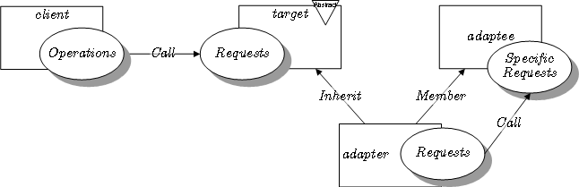
Adapter
Notes:
<number>

Slide 7
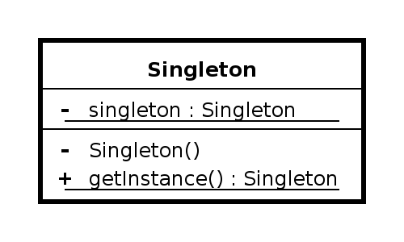
Singleton
Notes:
<number>

Slide 8
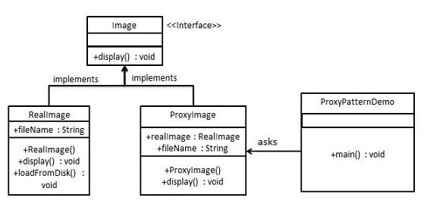
Proxy
Notes:
<number>

Slide 9
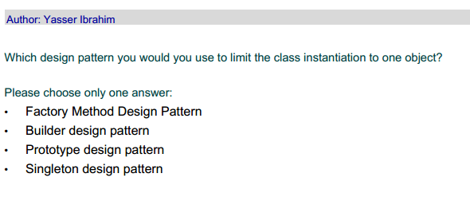
Warm UP
Notes:
<number>

Slide 10
Warm UP
Notes:
<number>

Slide 11
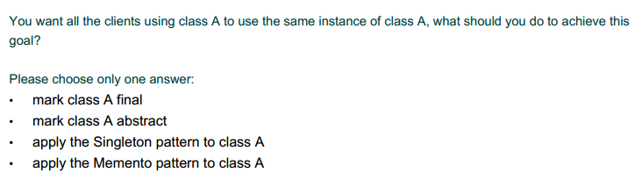
Warm UP
Notes:
<number>

Slide 12
Warm UP
Notes:
<number>

Slide 13
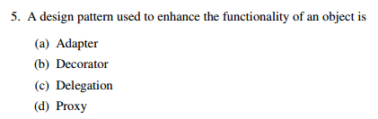
Warm UP
Notes:
<number>

Slide 14
Warm UP
Notes:
<number>

Slide 15
Concept
What does it mean to design for the interface versus design for the implementation?
Notes:
<number>

Slide 16
Concept
What does it mean to design for the interface versus design for the implementation?
Following this principle leads to code that exhibits loose coupling among classes. Examples of these benefits include:
Better testability. Classes that are not under tests can be substituted with fakes that implement the same interface. I.e you could substitute AJAXLibrary with FakeAJAX if the class just expects anything that implements an interface RemoteCallLibrary.
Better code reuse. If you have a routine that can sort anything that implements Comparable interface, you can now sort almost anything pretty easily instead of writing sorts for every type of object.
Notes:
<number>

Slide 17
Concept
When to use design patterns?
Notes:
<number>

Slide 18
Concept
What is the difference between architecture and design?
Notes:
<number>

Slide 19
Concept
What is the difference between architecture and design?
Architectural styles: Broad approaches to solving problems (pipes & filters, object-oriented, tiers, repository, etc.) that define which underlying tools are available to be used by patterns. These must be decided early, as they provide the general approach that is implemented.
Basic design patterns: Refer to how the internals of a component are arranged in order to solve problems. These are decided on as the problem they solve arises. e.g. An iterator is introduced when an operation must be applied to every component of a data structure.
Design patterns specify a general solution schema for problems that is known to have certain desirable properties.
Notes:
<number>

Slide 20
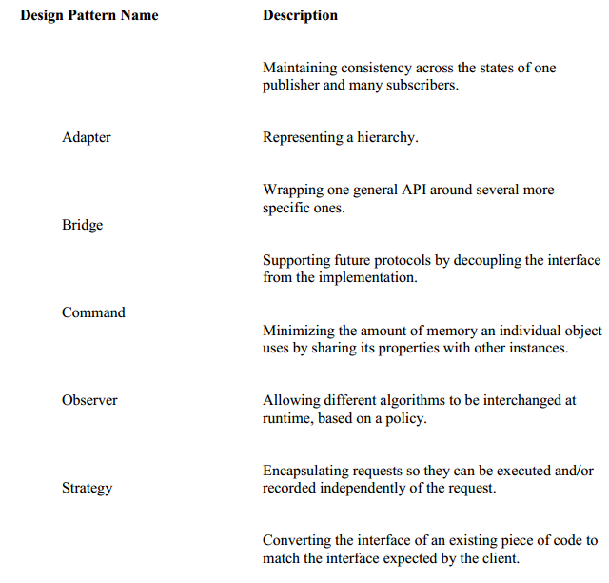
Matching
Notes:
<number>

Slide 21
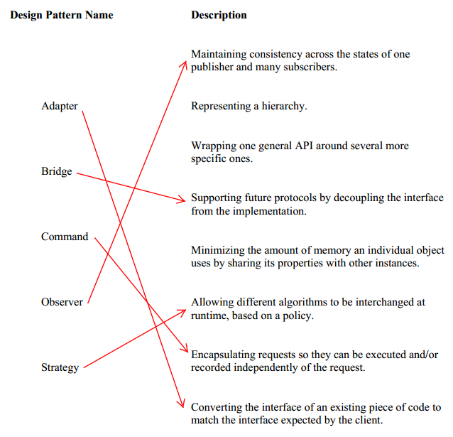
Matching
Notes:
<number>

Slide 22
Case Study
ParkingMontreal.com is a new system to track the availability of parking spots around the city of Montreal. This system will provide services both to the public, by helping them find nearby available parking spots, and to the City of Montreal parking attendants, by helping them locate parked cars whose meters have expired. Users who are registered with ParkingMontreal.com can also pay for their parking spot using their cellular phone. And, of course, the general public still has the option to pay for parking using the existing kiosk-based system.
Notes:
<number>

Slide 23
References
http://www.tutorialspoint.com/design_pattern/design_pattern_overview.htm
Factory: https://www.youtube.com/watch?v=ub0DXaeV6hA
http://s3.amazonaws.com/docuum/attachments/2139/Old%20final%20winter%202008.pdf?1240434717
https://cs.uwaterloo.ca/~a78khan/cs446/additional-material/scribe/99-exams/1005-Final_exam-Solutions.pdf

